Slide 1
World Immunization Progress
Lisa Cannon, Shilpa Muralidhar, Brian Labelle

Slide 2
Introduction
What is vaccination?
What does it do?
Why is it important?

Slide 3
Motivation
My background in vaccine research
Availability of datasets for our analyses that are:
Large
Reliable
Clean

Slide 4
Datasets
Vaccine 14 vaccines data from UNICEF
BCG, RCV, MCV1, 2, PCV, DTP1, 3 -prevents Tuberculosis, Rubella, Measles, Pneumonia, Diptheria
HiB - Meningitis,
ROTAC- prevents intestinal infections
Hepb3, Hepbb- prevents hepatitis
IPV, POL3 – prevents polio disease
YFV- prevents yellow fever

Slide 5
Datasets
UNICEF regions –
ECAR – Europe and Central Asia
EAPR– East Asia and Pacific
ESAR - East, South Africa
MENA- Middle East and North Africa
ROSA - South Asia
WCAR- West, Central Africa
LACR - Latin America , Caribbean
CEECIS- Russia, Eastern Europe
Industrialized - Scandavia, Western Europe, USA, Japan, Australia, Israel
Population data from World Bank

Slide 6
Goals
Which countries are better vaccinated than others?
What are the causes of variation?
Does vaccination decrease infant mortality?
Does it increase life expectancy?

Slide 7
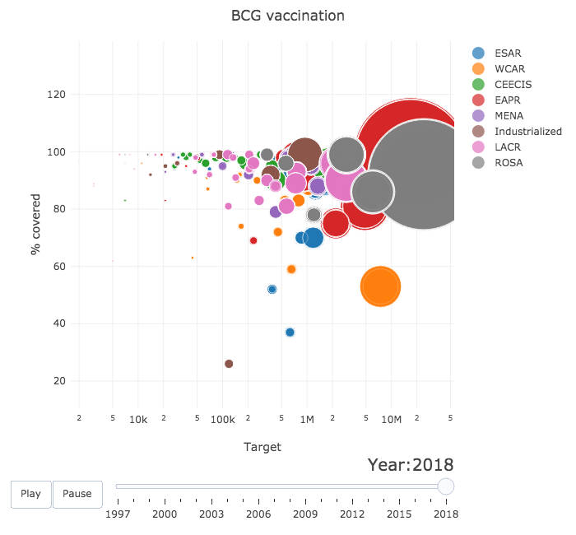
Who fares better?

Slide 8
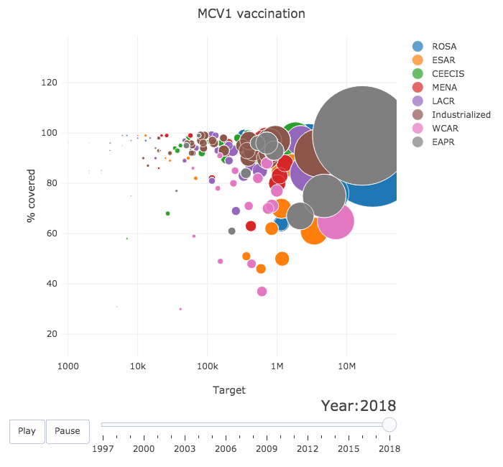
Who fares better ?

Slide 9
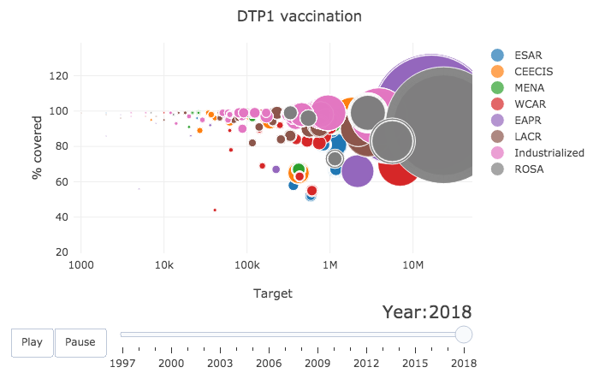
Who fares better ?

Slide 10
Analysis

Slide 11
Regression

Slide 12
Principal Component Analysis?

Slide 13
Conclusion

Slide 14
Questions

